Slide 1
Smart Cities Address Equity: The Case of Low-Income Energy Burdens
Marilyn Brown, Regents’ Professor
Georgia Institute of Technology*
Georgia Smart Fall Workshop
September 6, 2018
Atlanta, Georgia
*Lessons from an ongoing Georgia Tech research project
(https://cepl.gatech.edu/projects/low_Income)

Slide 2
What is an Energy Burden?
There is no widely accepted value or threshold that establishes whether a household faces a high or unaffordable energy burden. (ACEEE, 2017)
However, the U.S. Department of Health and Human Services classifies an energy burden of above 6% as “unaffordable” (Colton, What is the Home Affordability Gap, 2017)
Mean Household
Energy Bill*
*Electric & Gas
Energy Burden
Mean Household Income

Slide 3
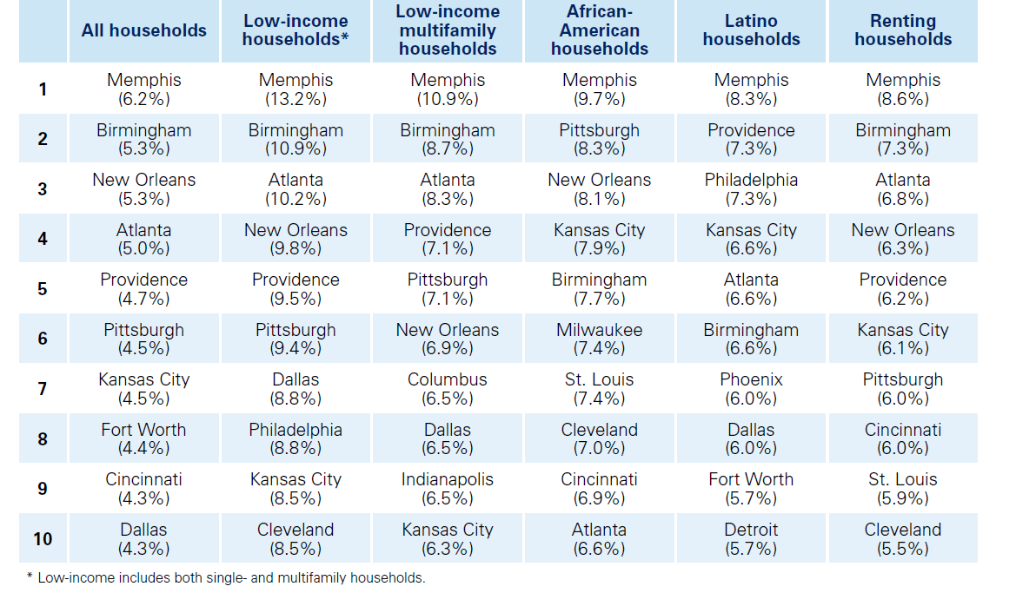
Impetus for Study
Energy burdens in the 10 most burdened U.S. cities.
Source: ACEEE, Lifting the High Energy Cost Burden in America’s Largest Cities: How Energy Efficiency Can Improve Low Income and Underserved Communities
Notes:
Nationally, Atlanta ranks 4th highest in median energy burden levels (behind Memphis, New Orleans & Birmingham) and 3rd highest among low income household populations
Energy Burden is Particularly High Among Low-Income MF, Latino, and Renting Households

Slide 4
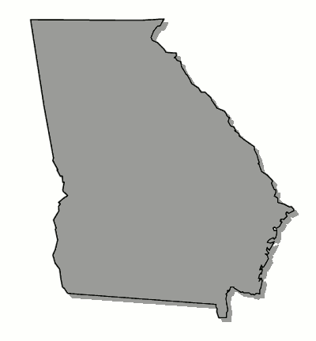
Many Factors Contribute to High Energy Burdens in Georgia
Numerator
Denominator
35th in EE policies
2nd highest residential natural gas prices in country
5th highest average temperature in country
Among highest in air conditioning and space heating use
41st in per capita income
~45% of Southern Co. customers at or below $40K income (Southern Co.)
The Southeast lags behind the rest of the nation in terms of % of residents living in poverty
Source: EIA, Household Energy Use in Georgia

Slide 5
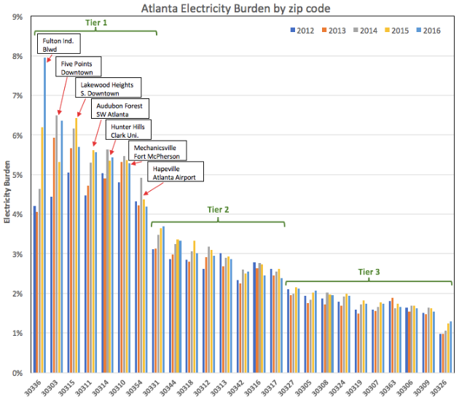
Electricity Burdens in Low-Income Zip Codes of Atlanta are Growing
Atlanta Electricity Burden by Zip Code
Electricity burdens in Tier 1 increased from 4.7 to 5.4% 2012-2016
They increased from 2.8 to 3.0% across all 25 zip codes
Notes:
25 Zip codes in Atlanta
Range is between 0.3% to 7.5%
Energy Burden is increasing for low income families, especially in the Tier 1 zip codes.
Tier 1 electricity use increased 346 kWh/year (0.9%) 2012-2016 for Tier 1 and for all 25 zip codes

Slide 6
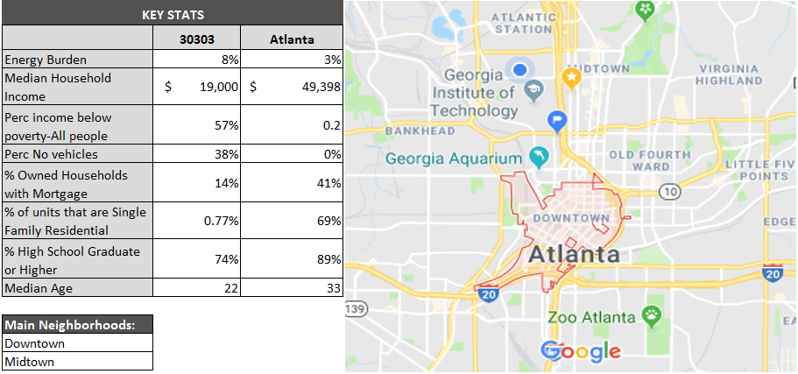
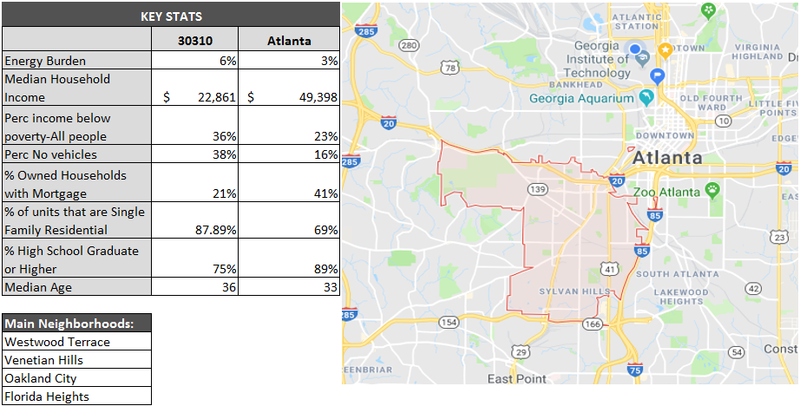
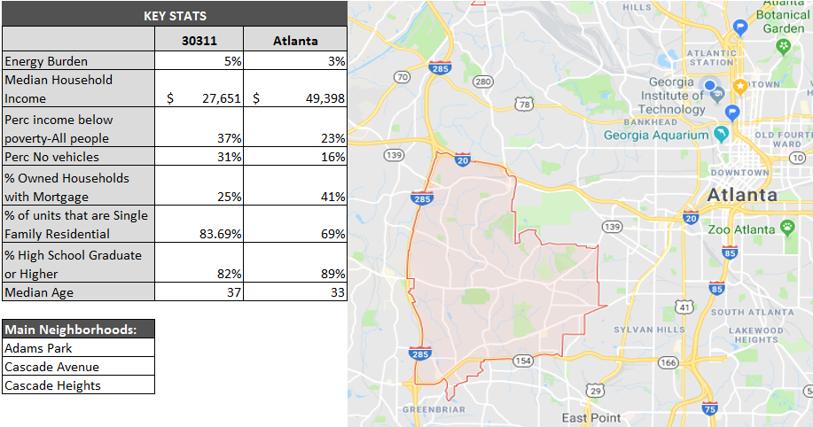
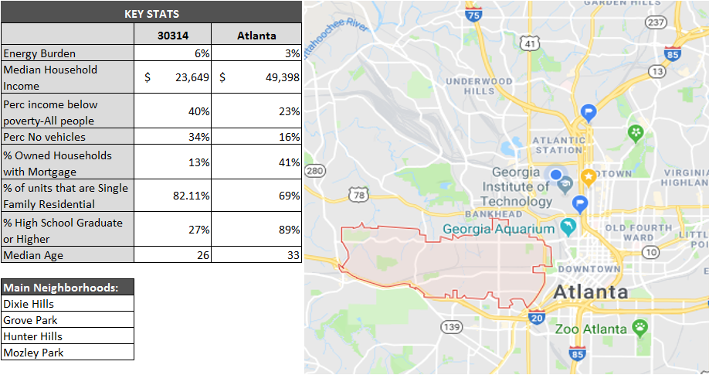
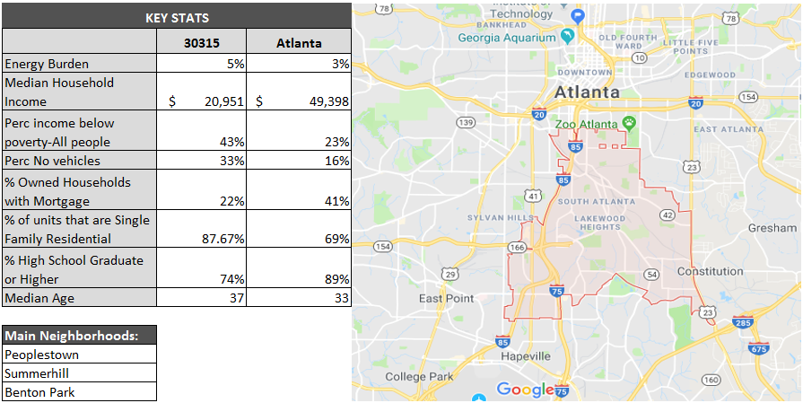
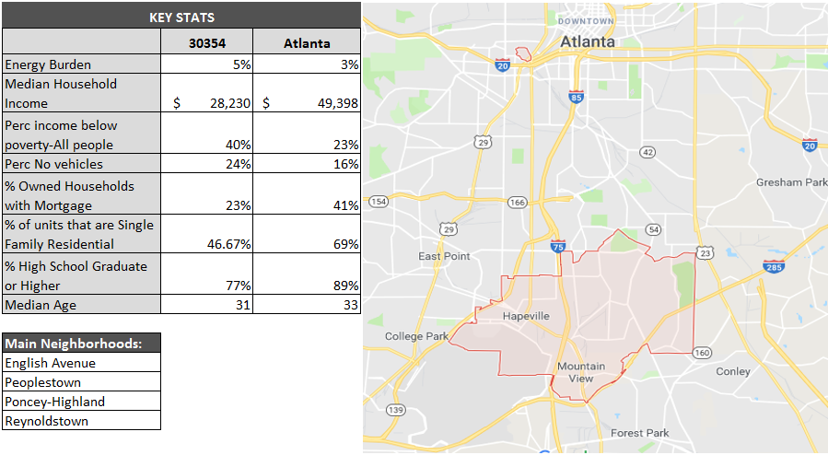
What do these Tier 1 Zip Codes Look Like?
Notes:
In 2014, the average energy burden for Atlanta households was 2.9%.
For the 6 zip codes with the highest levels of poverty, the average energy burden in 2014 was 5.7%.

Slide 7
Solutions: Expanded Partnerships & New Technologies
Low-Income Households
Assess connections and gaps for optimizing the available pool of funding for structural repairs and safety, weatherization and energy efficiency, and water.
Motivate innovative technologies for low-cost retrofits and approaches to personal comfort
Prepare a baseline on education and awareness of energy efficiency and related resources among the residents of high energy-burdened communities
Engage new information and communication technology to promote greater awareness
Core Principle: Awareness needed to link energy use & behavior

Slide 8
Cities: Energy Benchmarking, Green Leases, and “Trusted Contractors”
The City of Atlanta
Mandated residential energy benchmarking (building code inspections and home energy ratings required when residential properties are sold)
“Model” green lease made available to owners & tenants of MF rental units
Work with absentee landlords of low-income rental units to promote energy affordability and sustainable development in one or more targeted zip codes
Develop network of “trusted contractors”—like Solarize Atlanta’s choice of Creative Solar and Hannah Solar
Core Principle: Addressing the landlord/tenant problem

Slide 9
Utilities: Treat Affordable Energy as a “Material Issue”
Utilities
Quantify arrearages, bad debt, disconnects and health benefits to justify expanding low-income program investments
On-bill financing for owner-occupied housing
Energy affordability is a material issue for utilities
Core Principle: Business case for scaling low-income utility programs requires coordinated, cost-shared partnerships.
*Electric Power Research Institute
**Global Reporting Initiative/Sustainability Accounting Standards Board

Slide 10
Public Service Commission: Align Incentives
The PSC and other State and Federal Partners
Regulatory frameworks are needed to incentivize EE (& low income) programs via new/modified cost tests & non-energy benefits (NEBs)
Rate designs can help or hurt and needs analysis
Existing programs can be leveraged and coordinated
Core Principle: Energy burden is complex with solutions
to root causes necessitating public policy reform + incentives.
Source: Brown, Marilyn A., Benjamin Staver, Alexander M. Smith, and John Sibley. 2015. Alternative Business Models for Energy Efficiency: Emerging Trends in the Southeast, The Electricity Journal, 2015, 28 (4): 103-117.

Slide 11
The philanthropic community can promote success across all of these solutions. Thank you.

Slide 12
Research Team & Collaborators
Team Member | Organization
Dr. Marilyn Brown (CO-PI) | School of Public Policy Ivan Allen College of Liberal Arts Brook Byers Institute for Sustainable Systems Georgia Institute of Technology
Michael Oxman (CO-PI) | Ray C. Anderson Center for Sustainable Business at Scheller College of Business Georgia Institute of Technology
Dr. Beril Toktay (CO-PI) | Ray C. Anderson Center for Sustainable Business at Scheller College of Business Georgia Institute of Technology
Majid Ahmadi | School of Public Policy (Climate & Energy Policy Laboratory) Georgia Institute of Technology
Naveed Ahmad | Scheller College of Business Georgia Institute of Technology
Yasaman Mohammad Shahi | H. Milton Stewart School of Industrial & Systems Engineering Georgia Institute of Technology
Suzanne Burnes Naajia Ahmed | Collective Wisdom Group
Sabrina Cowden Erik Froyd | Milepost Consulting
Collaboration Highlights:
Business, Public Policy, Engineering Expertise
Faculty & Student Collaboration
Enhanced stakeholder engagement via knowledgeable contractors
Thanks to Southern Company and Georgia Power for providing mean values of household electricity and natural gas consumption data by zip code. Funding from Georgia Tech’s Energy Policy and Innovation Center is appreciated.

Slide 13
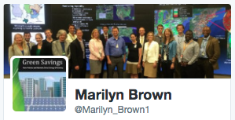
Contact Information
Dr. Marilyn A. Brown, Regents Professor
Brook Byers Professor of Sustainable Systems
School of Public Policy
Georgia Institute of Technology
Atlanta, GA 30332-0345
Marilyn.Brown@pubpolicy.gatech.edu
Climate and Energy Policy Lab:
www.cepl.gatech.edu
2016 2015 2013

